Slide 1
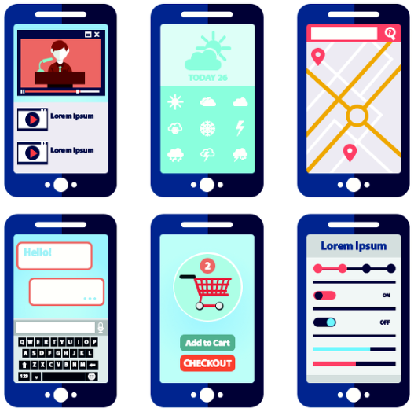
스마트폰과 적용기술
2020.10

Slide 2
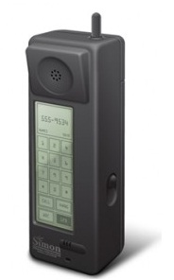
스마트폰의 역사
최초의 스마트폰
IBM사의 사이먼(Simon)
세계 최초의 터치스크린 핸드폰(1993년), 박람회
전화, 주소록 저장, 세계시각, 계산기, 메모장,
전자우편, 팩스 송수신, 오락 등의 기능

Slide 3
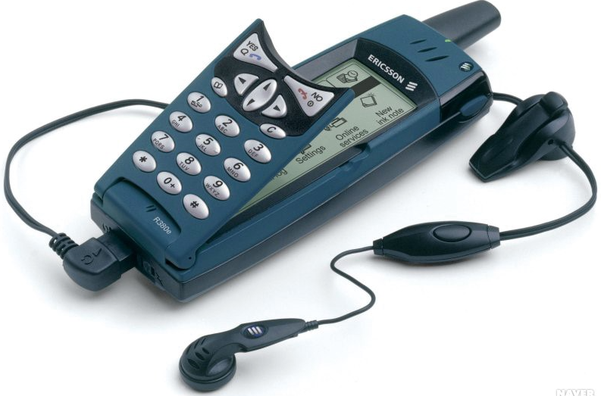
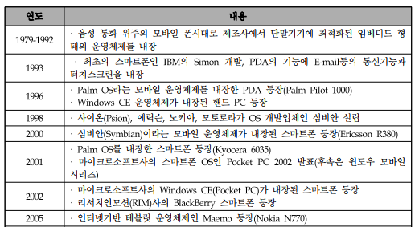
모바일과 스마트폰
(스웨덴)

Slide 4
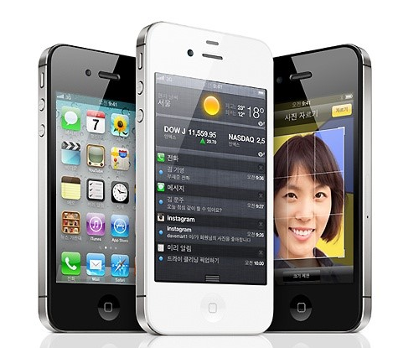
스마트폰의 역사
2007
Apple사 Iphone
국내 2009,12월 판매
국내 플랫폼 경쟁 과열

Slide 5
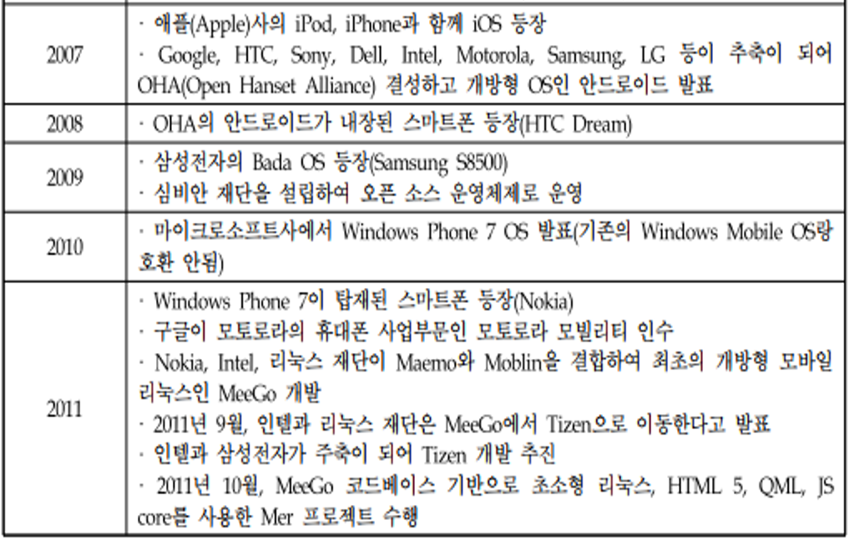
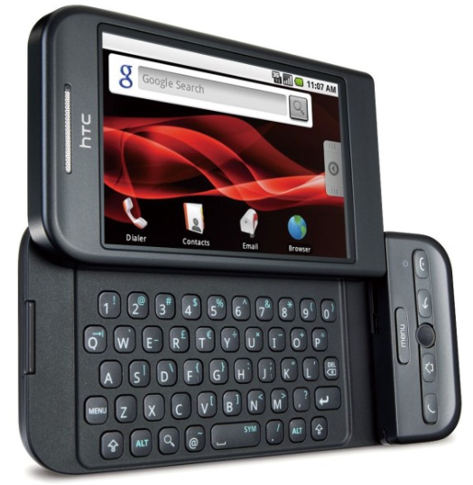
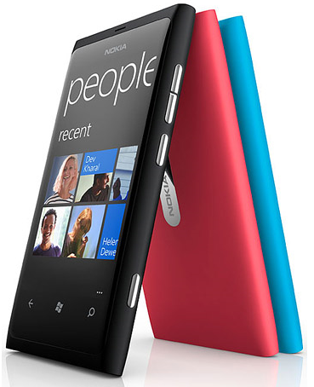
모바일과 스마트폰
(대만)안드로이드 최종 탑재
루미아 710

Slide 6
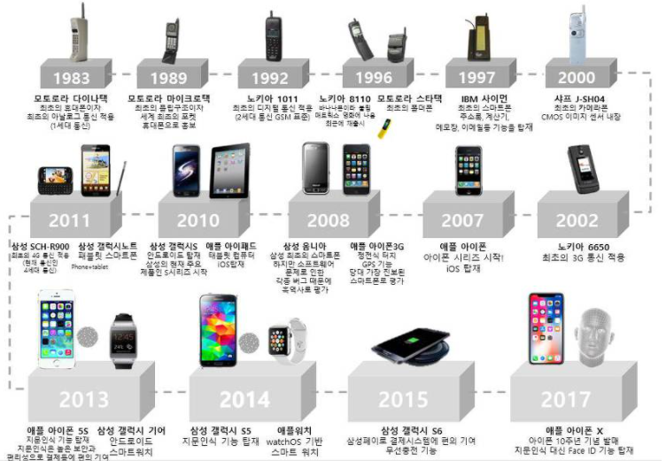
스마트폰의 발전

Slide 7
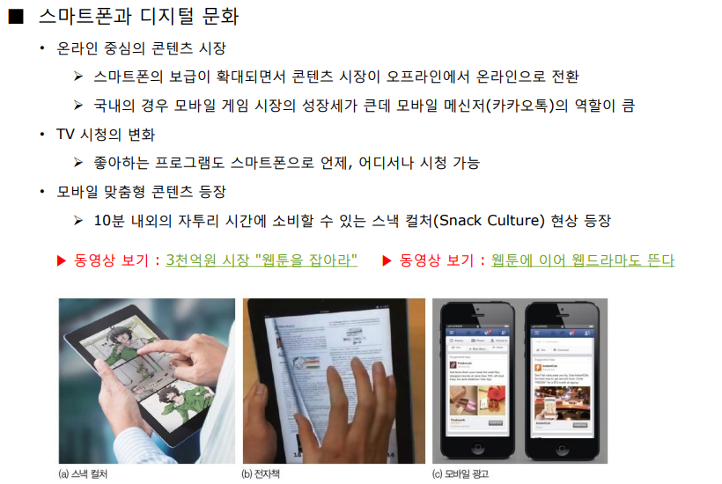

스마트폰과 디지털
짧은 시간에 문화 콘텐츠를 소비(웹툰, 웹 소설,
웹 드라마 등)

Slide 8
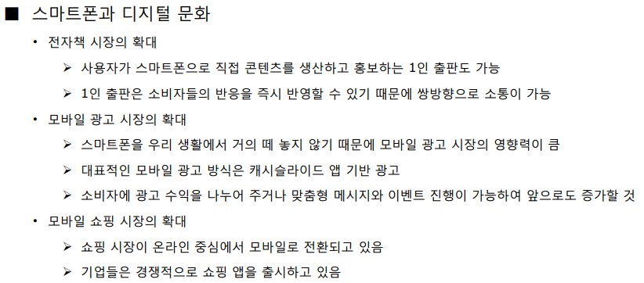
스마트폰과 디지털

Slide 9
What is a Mobile Operating System?
set of data and programs that runs on a computer or mobile device.
It manages all the hardware and optimizes the efficacy of the application software in the device.
manages mobile multimedia functions, mobile and Internet connectivity and so on in a mobile device.

Slide 10
What is a Mobile Operating System?
Mobile OS’ are seen in smartphones powered by the iOS, BlackBerry OS, Windows Mobile, Android, Symbian and so on.

Slide 11
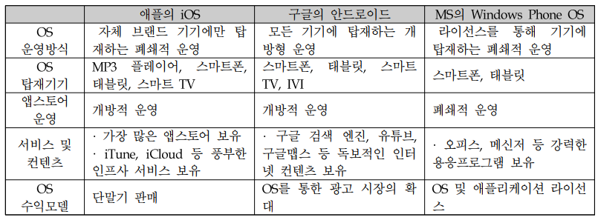
Mobile Operating System의 비교분석

Slide 12
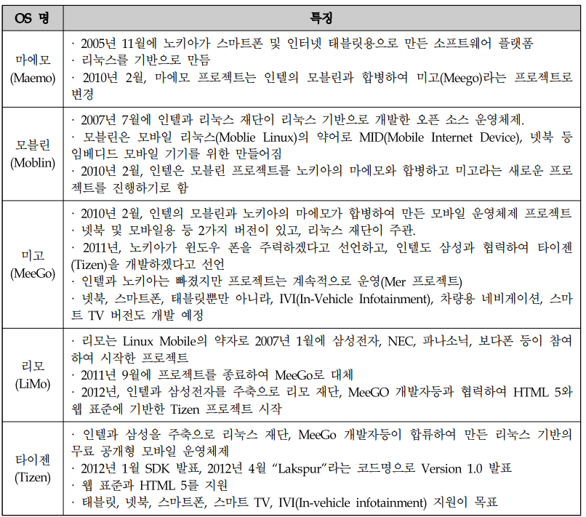
리룩스기반의 모바일 운영체제

Slide 13
Design of a Mobile OS
Design and capabilities of a Mobile OS is very different than desktop OS
mobile devices have constraints and restrictions their physical characteristic
ex) screen size, memory, processing power and etc.
availability of battery power(한계)
Limited amount of computing and communication capabilities
operating systems depending on the capabilities they support.
management of operations, control, coordinate the use of the hardware, and sharing the resources of a device.

Slide 14
Mobile OS Structure
A mobile OS is a software platform on top of which other programs called application programs, can run on mobile devices such as PDA, cellular phones, smartphone and etc.
Applications
OS Libraries
Device Operating System Base, Kernel
Low-Level Hardware, Manufacturer Device Drivers
Hardware Device

Slide 15
Mobile OS Platforms
There are many mobile operating systems. The followings demonstrate the most important ones:
Java ME Platform
Palm OS
Symbian OS
Linux OS
Windows Mobile OS
BlackBerry OS
iPhone OS
Google Android Platform

Slide 16
Java ME Platform
J2ME platform is a set of technologies, specifications and libraries developed for small devices like mobile phones, pagers, and personal organizers.
Java ME was designed by Sun Microsystems. It is licensed under GNU General Public License

Slide 17
Palm OS
Palm OS is an embedded operating system designed for ease of use with a touchscreen-based graphical user interface.
It has been implemented on a wide variety of mobile devices such as smart phones, barcode readers, and GPS devices.
It is run on Arm architecture-based processors. It is designed as a 32-bit architecture.

Slide 18
Symbian OS
Symbian OS is 32 bit, a multitasking operating system and very less dependence on peripherals of ARM architecture.
Kernel runs in the privileged mode and exports its service to user applications via user libraries.
User libraries include networking, communication, I/O interfaces and etc.

Slide 19
Windows Mobile OS
Windows Mobile is a compact operating system designed for mobile devices and based on Microsoft Win32.
It is run on Pocket PCs, Smartphones and Portable media centers.

Slide 20
iPhone OS
iPhone OS is an operating system run on iPhone and iPod.
It is based on Mach Kernel(분산, 병렬 컴퓨팅) and Darwin core as Mac OS X.
The Mac OS X kernel includes the following component:
Mach Kernel
BSD
I/O component
File Systems
Networking components

Slide 21
iPhone OS
The following is Mac OS X Architecture :
Classic
Carbon
Cocoa
JDK
BSD
QuickTime
Application Services
Core Services
Kernel Environment
Carbon, Cocoa : 애플 환경에서 애플리케이션을 제작하기 위한 도구들의 모음 (프레임워크, Platform)

Slide 22
Google Android Platform
It is a platform and an operating system for mobile devices based on the Linux operating system.
It allows developers design applications in a java-like language using Google-developed java libraries.
It supports a wide variety of connectivity such as GSM, WiFi, 3G, …

Slide 23
Android
Android is a mobile operating system
OS for smart phone (or devices)
made by Google.
Android applications:
For mobile users
Written in Java programming language

Slide 24
Android
Linux kernel
Operates and maintains hardware of mobile devices
Android framework
The framework connects Android applications and the Dalvik virtual machine and libraries.

Slide 25
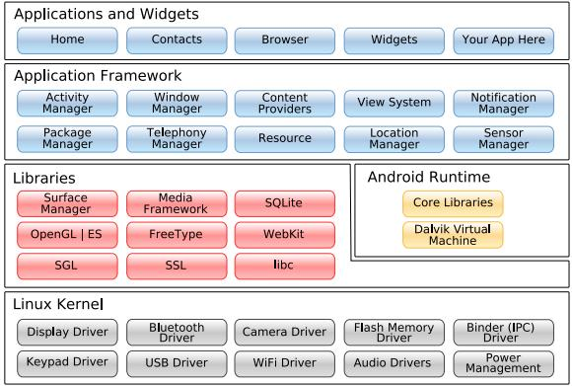
Android platform

